Slide 1
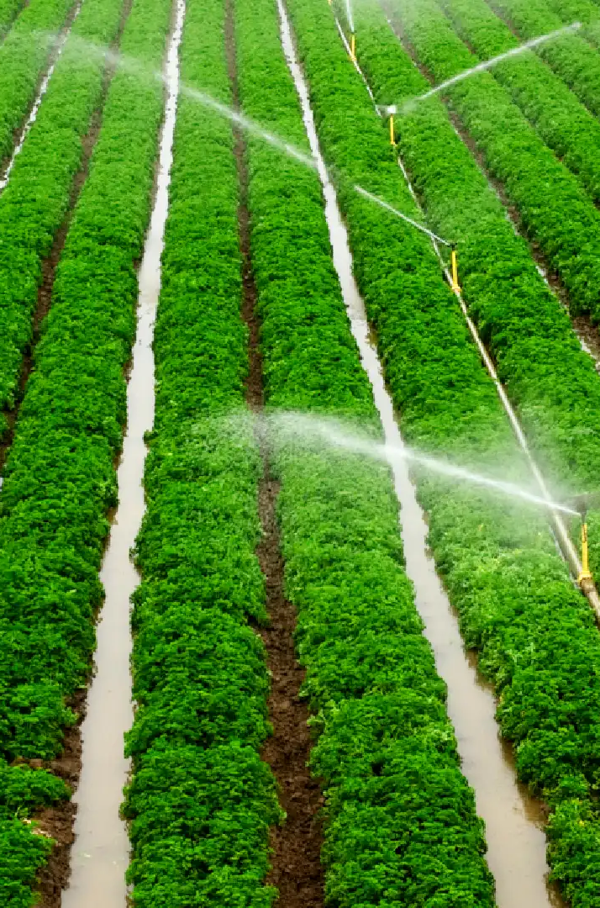


THE OASIS SMART VALVE SOLUTION
For Water and Energy efficiency in agriculture
CSME/CFD2024 – Canadian Society for Mechanical Engineering International Congress
31st Annual Conference of the CFD Society of Canada
Davide Troiani – PhD Student
Professor Amy Bilton
Professor Stefano Malavasi

Slide 2
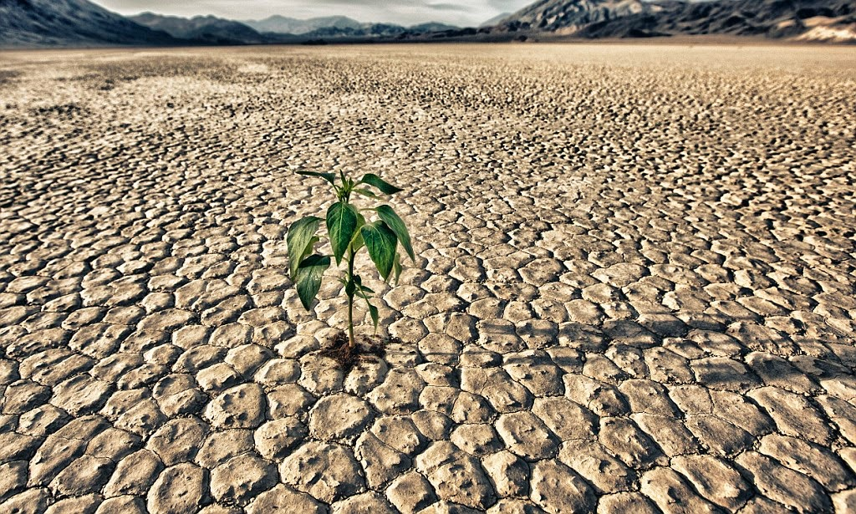


Problem
Freshwater share
01. Water scarcity
Climate change
Population Growth
Industry
02. Environmental Impact
Agriculture
Agriculture in the European Union accounts for approximately 11% of total greenhouse gas emissions.
Irrigation accounts for the highest share of water abstracted in Italy, (50%)
03. In-equality of water access
Civil
Not all users receive the same level of service.
(FAO 2023. Giornata mondiale dell’alimentazione)
2

Slide 3

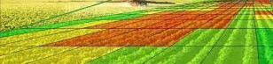

Models and data mining
Problem
There exists a technological disparity between proposed research solutions and the available technologies at the field level.
Opportunity
Water utilities are increasingly seeking control and monitoring devices that can be operated remotely, wirelessly, and in real-time. These tools enable the implementation of management strategies aimed at enhancing water quality and sustainability.
State of the art management requires sophisticated devices
The integration of up-to-date machinery, drones, GIS tools, and local monitoring systems is essential. However, despite these advancements, users often still require physical action to control the hydrants.
Field application at user and utility level
3

Slide 4
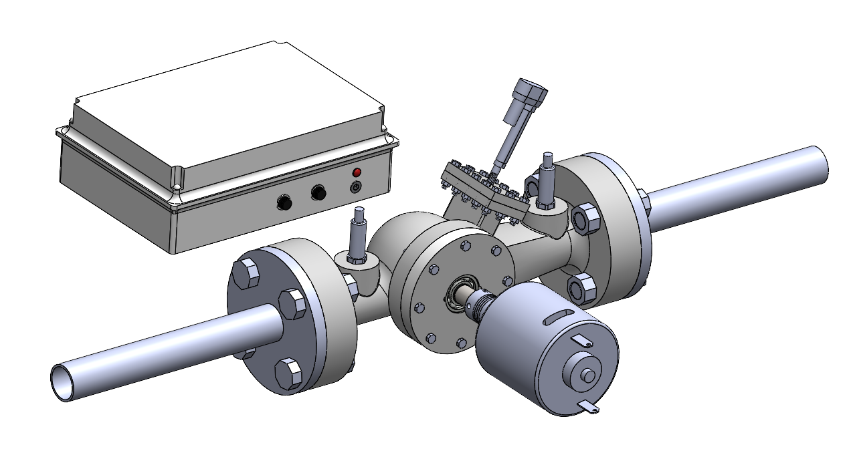

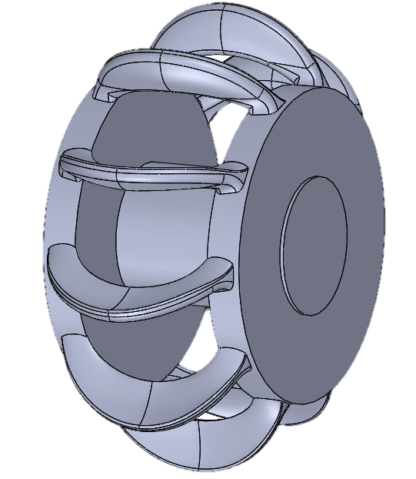



Technology
Control Box
Actuator
OASIS – Off Grid Automatic System for Irrigation Sustainability
Smart valve capable of recovering energy from the throttling process through a turbine housed inside. The recovered energy powers a system of measurement instruments and logic components for real-time remote control of the device
OAS
Main Components:
OAS Valve
Electric Linear Actuator
Control Box
Generator
2 Pressure Transducers
Generator
Patented by Politecnico di Milano in 2020
4

Slide 5
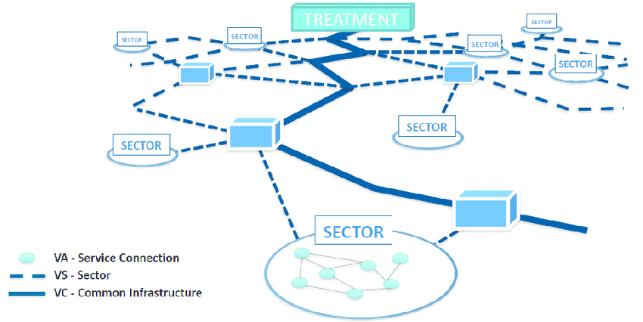
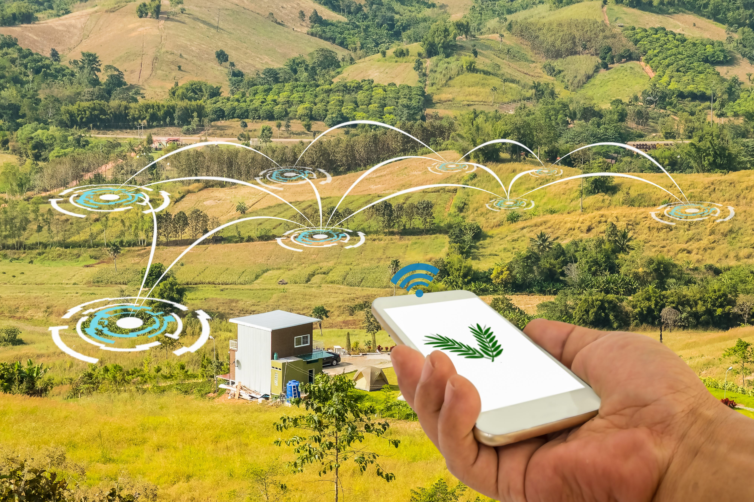
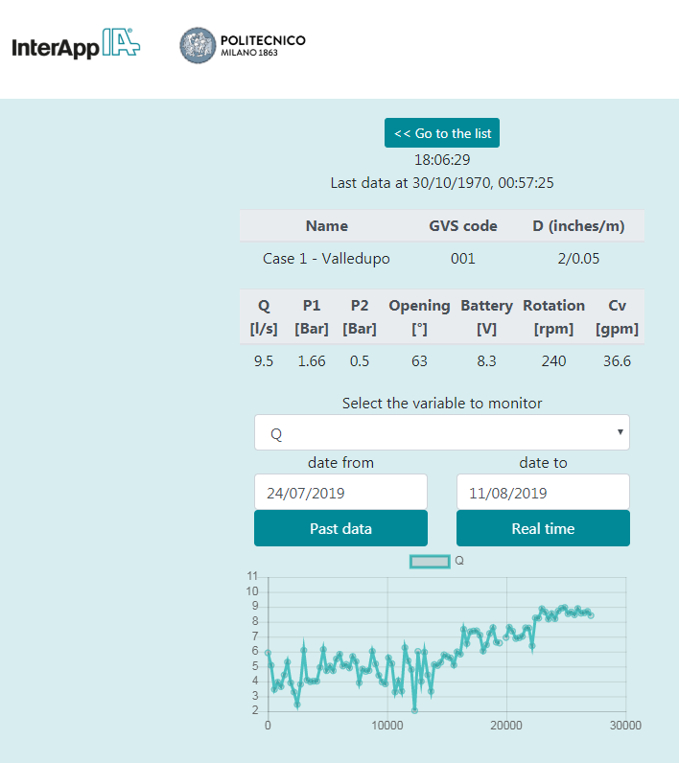
Solution
Off-Grid
device
A self-sustainable device harnessing energy from fluid flow
Remote Control
Remote control capabilities enable the implementation of effective water management strategies
Real-Time Monitoring
Sustainable automation ensures fair and equitable access to water resources
The widespread adoption of such devices within the network creates a digital ecosystem that substantially enhances network management for both users and water utilities.
5

Slide 6



Device Operation
Logical Feature
Irrigation = Intermittent operation
extended periods of inactivity outside the irrigation season
Three Logical Operating Modes:
Active
Actively engaged to allow energy recovery and flow management
Standby
The valve remains closed during the irrigation season, awaiting further instructions
Deep Sleep
Activated during months without scheduled irrigation. Energy consuming activities are halted.
6

Slide 7
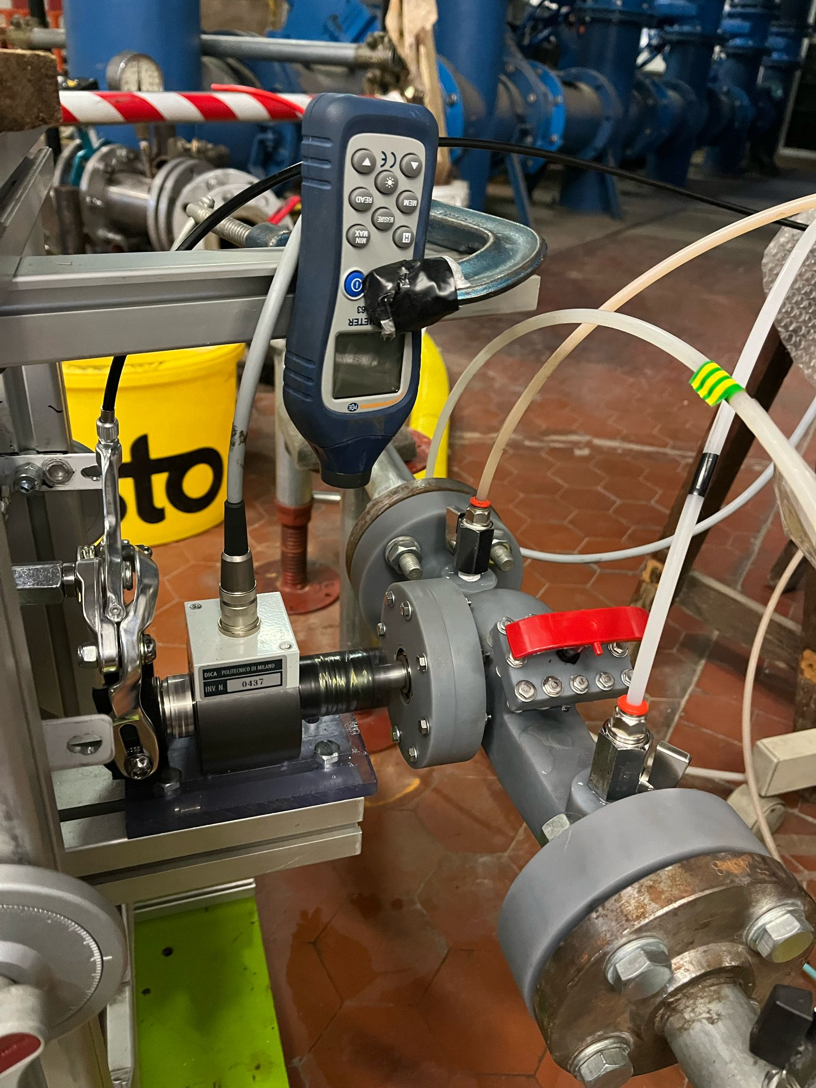
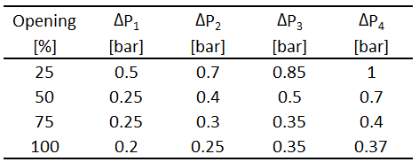
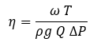
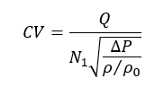
Experimental Campaign
Set-Up
The first OAS prototype, realized using stereolithography with TAF2000 resin, has been tested in the Control Valve Loop of the Fantoli Hydraulic Laboratory.
A total of 16 configuration have been analyzed, considering 4 different openings and 4 pressure differential across the valve for each gate positioning.
Energy harvesting
Pressure Management
Efficiency
Flow Coefficient
7

Slide 8
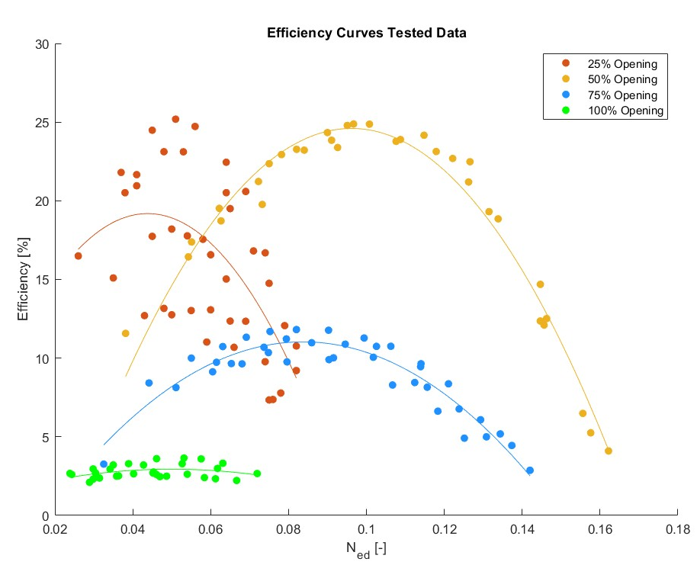
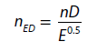
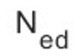
Experimental Campaign
Efficiency Results
Peak efficiency was achieved at the 50% opening condition
Middle opening exhibited less variability among the tested data.
η = 25%
Speed factor : ratio between rotational velocity and specific energy
8

Slide 9
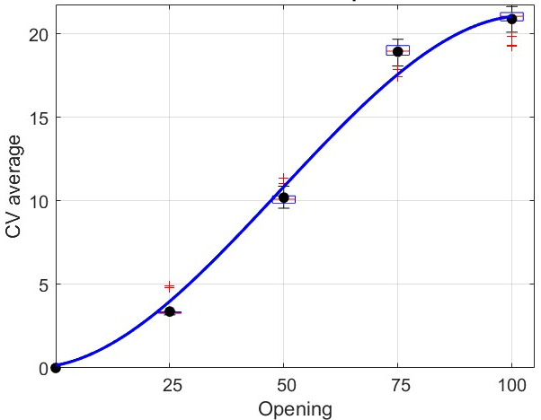
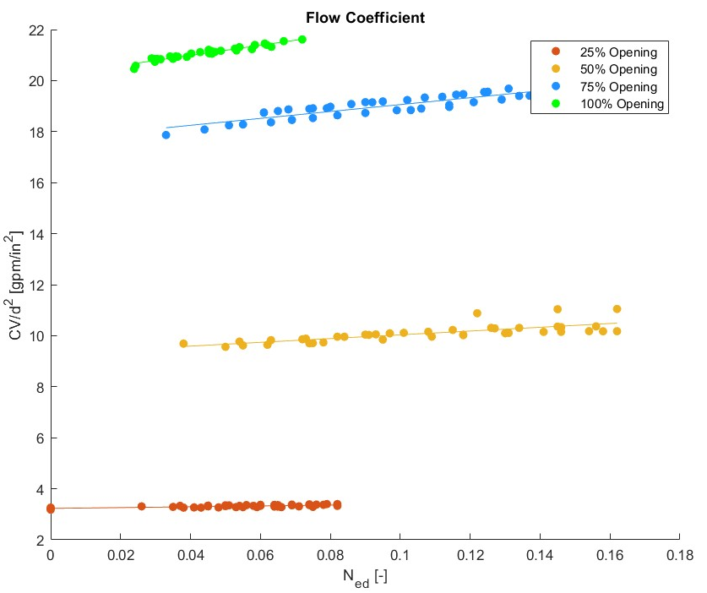
Experimental Campaign
Flow Coefficient Results
Experimental data shows that the flow coefficient for a fixed travel rate is minimally influenced by the rotational velocity of the turbine.
This characteristic enables the decoupling of the control process from the energy extraction.
It is possible to regulate the rotational velocity to achieve maximum efficiency without compromising control or altering operating conditions.
9

Slide 10
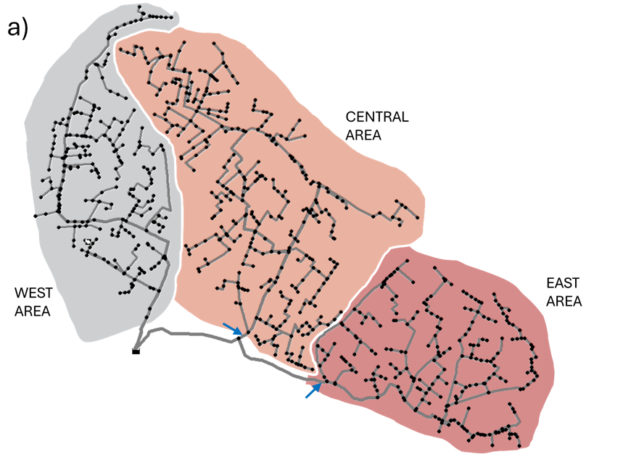
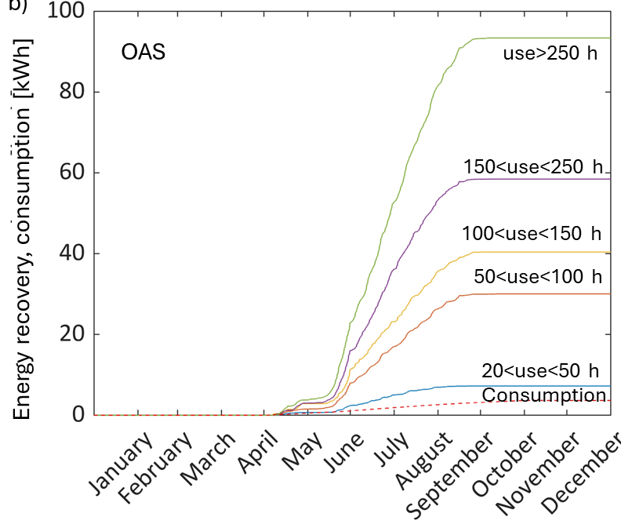
Feasibility Study
Case Study: UFITA network
Central Branch: 111 Hydrants
East Branch: 92 Hydrants
Real data was used to simulate the network's behavior using the hydraulic solver Epanet and its MATLAB toolkit, with a time step of half an hour throughout the entire irrigation season.
The installation of OAS at each node of the network has been investigated to assess the practical feasibility of recovering an adequate amount of energy for its operation.
OASIS Project - Troiani Davide
10

Slide 11
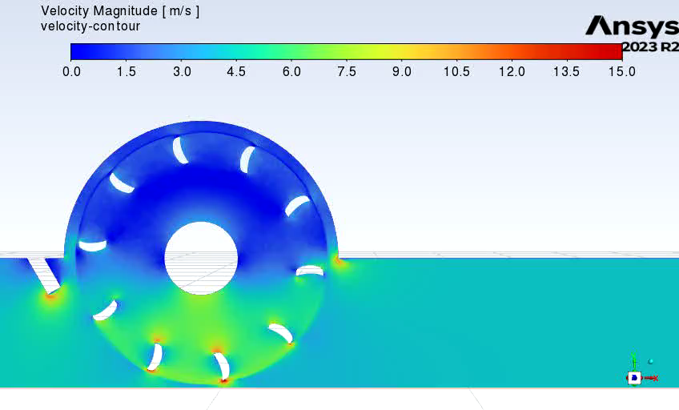
Numerical Campaign
CFD Model
A numerical model has been developed using Ansys.
Numerical optimization is ongoing using a Design of Experiments (DOE) Parameter study for the turbine chamber and various geometric features, including gate shape, internal fillet, and number of blades.
The subsequent phase will concentrate on optimizing the blade shape.
OASIS Project - Troiani Davide
11

Slide 12

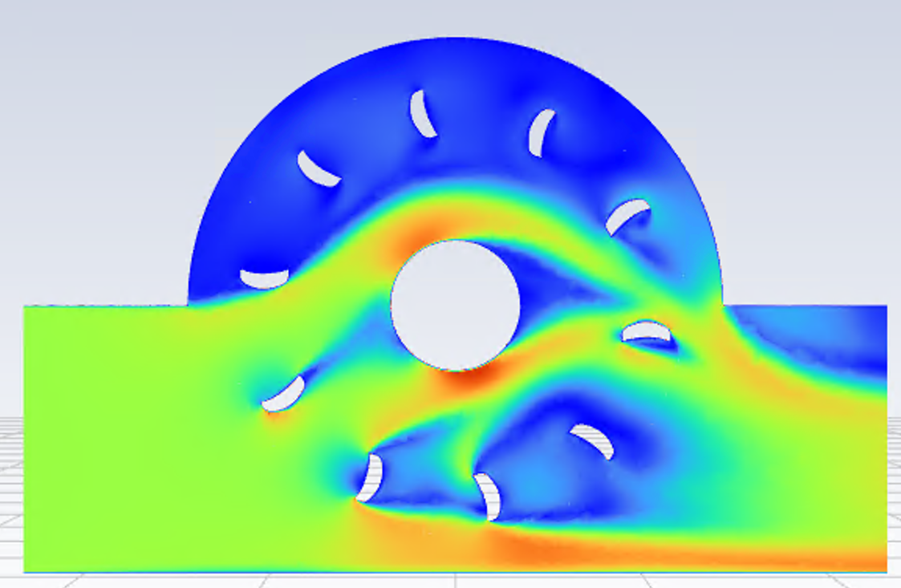
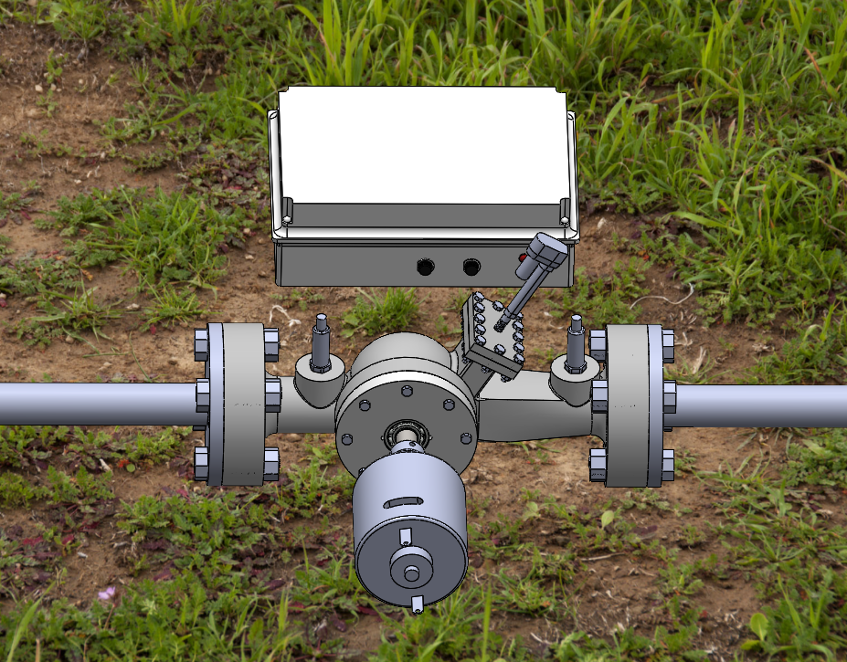
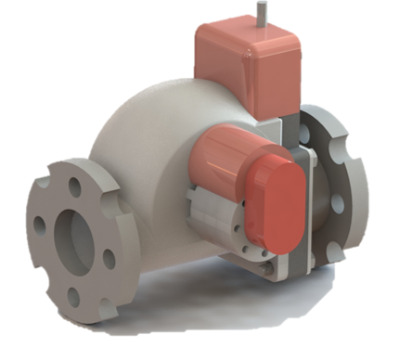
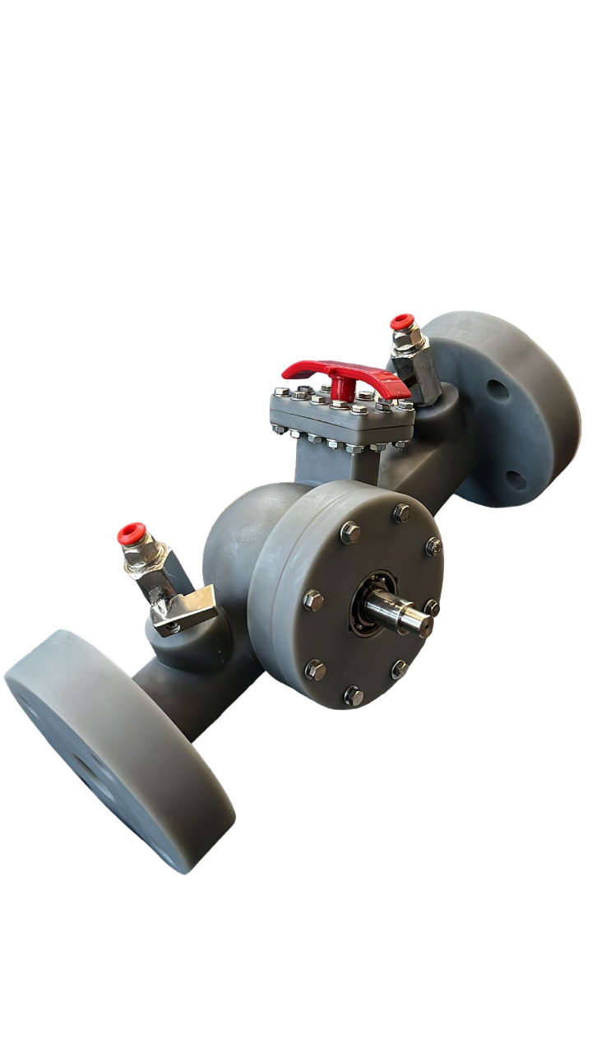

Project Roadmap
Ongoing numerical optimization
Experimental validation of numerical data
Field Installation
TRL 7
TRL 3
Research to prove feasibility: The concept was patented in 2020
First prototype tested in the laboratory
Logical components designed and currently under production
PATENT
OASIS Project - Troiani Davide
12

Slide 13


fluid
lab
Thanks !
davide.troiani@polimi.it

Slide 14
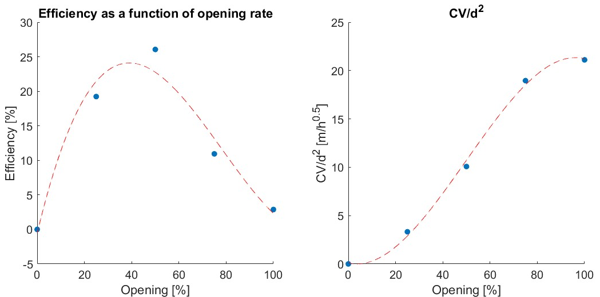
Experimental Campaign
Results

Slide 15
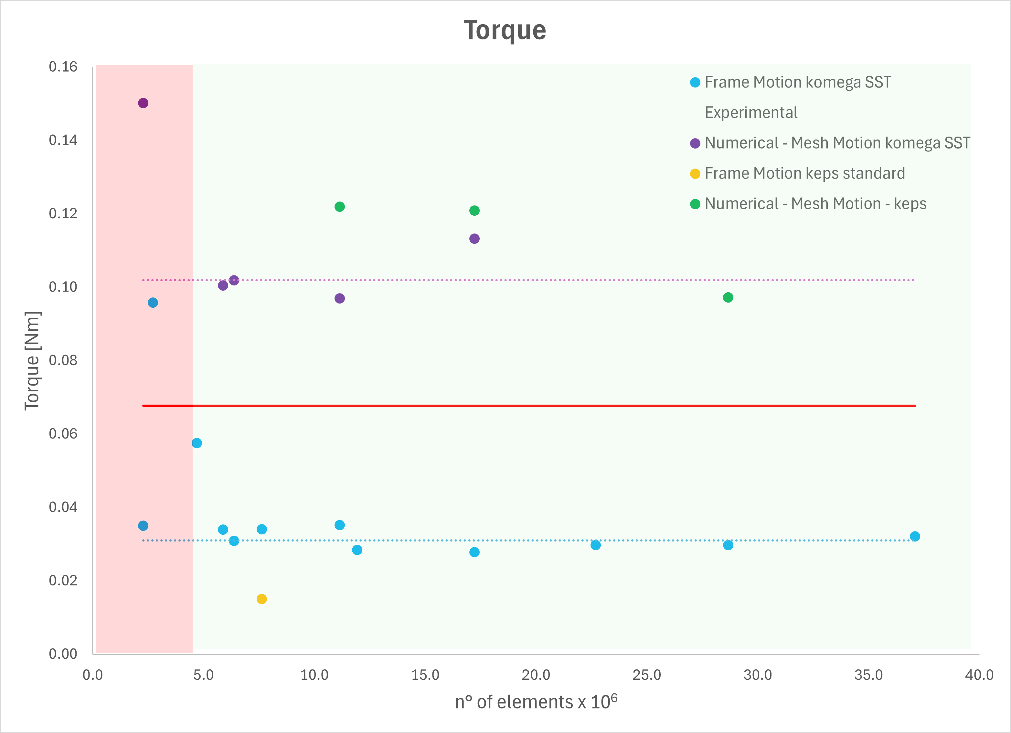
Numerical Campaign
Mesh Study
The mesh independence study has been conducted on the best efficiency point of the 75% opening case
Steady and transient simulation have been conducted with two different turbulence model (kε-Standard and kω-SST)
11 mesh analysed spanning from 2 mln elements to 37mln
OASIS Project - Troiani Davide

Slide 16
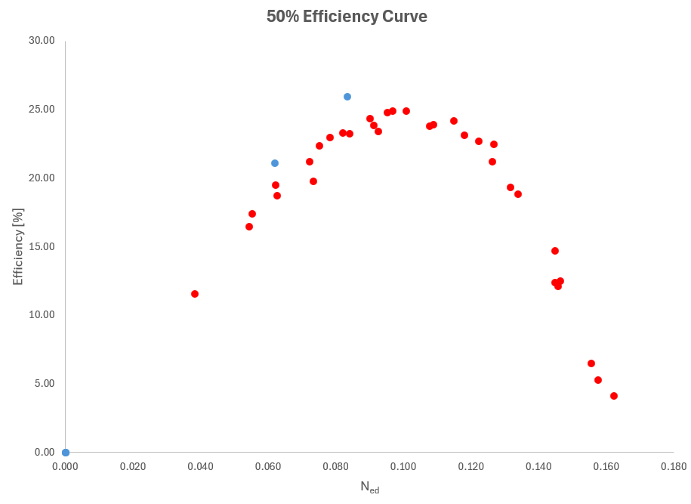
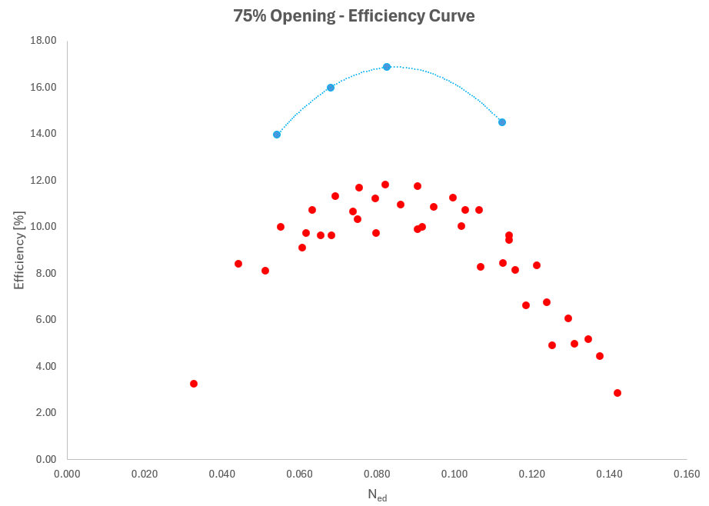
Numerical Campaign
CFD Model
OASIS Project - Troiani Davide

Slide 17
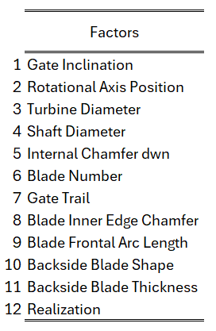
Numerical Campaign
Design Of Experiments
OASIS Project - Troiani Davide

Slide 18
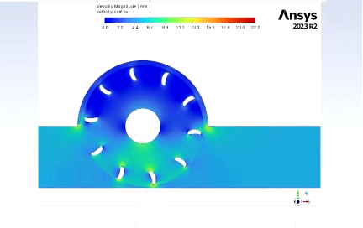

Slide 19

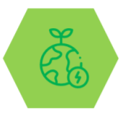
OASIS
Optimal water use
Top quality crops
Advantages
Utility
Farmers
For Water utilities
- implementation of innovative management strategies based on real time control and monitoring
- real-time information on network state
- limit hydrant operation in case of critical scenarios
- equitable and sustainable water distribution
Productivity
For Farmers
- real-time information for irrigation scheduling
- water quality monitoring for high quality crops
- remote operation on the system
- record of demand/supply
New policy scenarios and challenges
Large investments by national and international plans:
PNRR
5,27 MLD €
M2C1
15,06 MLD €
M2C4
«Sviluppo di una filiera agroalimentare sostenibile, migliorando le prestazioni ambientali e la
competitività delle aziende agricole»
«Garanzia della sicurezza dell’approvvigionamento e gestione sostenibile ed efficiente delle risorse
idriche lungo l'intero ciclo»

Slide 20
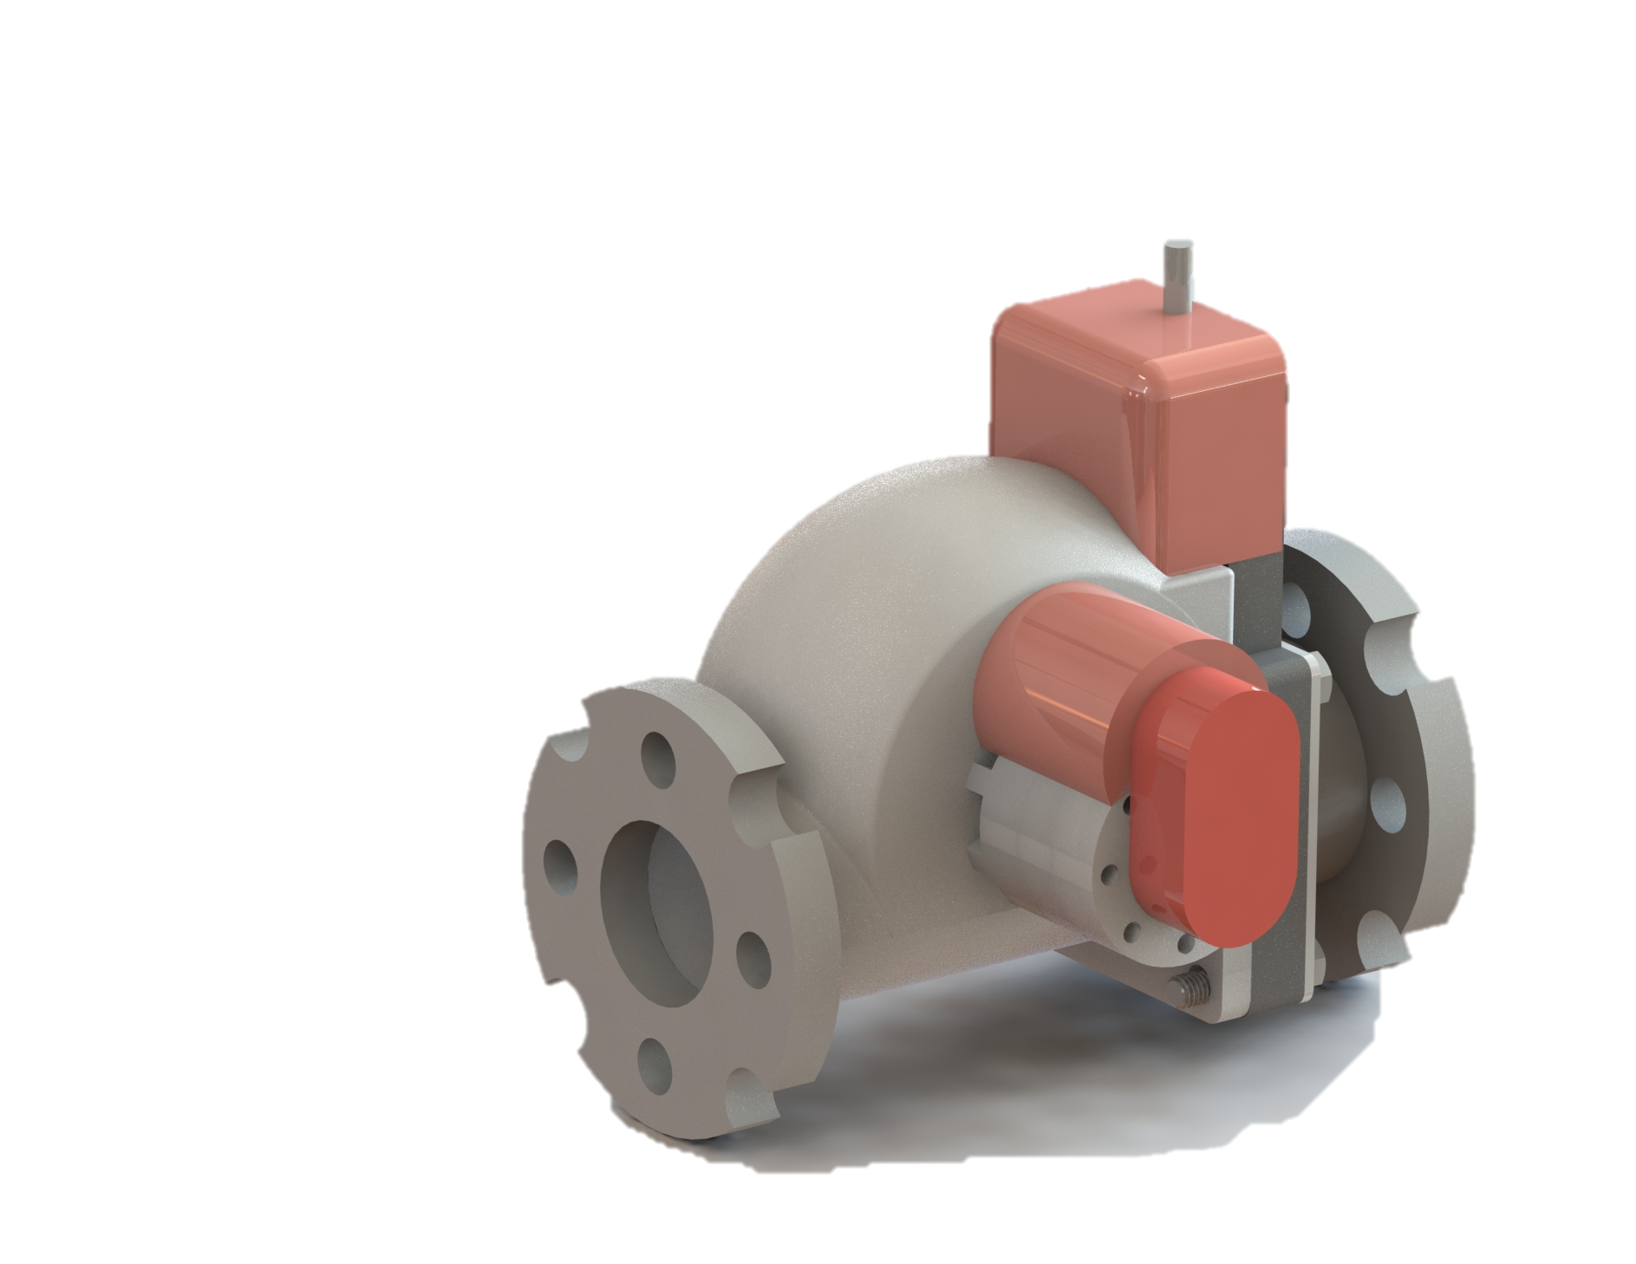
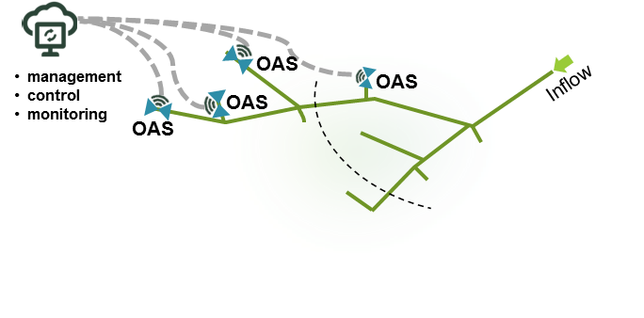
OASIS
Solution
OASIS (Off-grid Automatic System for Irrigation Sustainability)
OAS
POLIMI PATENT
New management opportunities for farmers and utilities

Slide 21

OASIS
Integrated solution
OAS
Competitive scenario
Competitors (indicative)
OASIS is a system which integrates flow monitoring and ccontrol with energy recovery, allowing to satisfy contemporary all of the users need
Competitors do not offer integrated solution specific for some of the functions
Off-Grid
device
Remote Control
Real-Time Monitoring
Self sustainable device recovering energy directly from the fluid flow
Remotely controlled allows for water management strategies implementation
Sustainable automation of the proceses to grant water equity

Slide 22
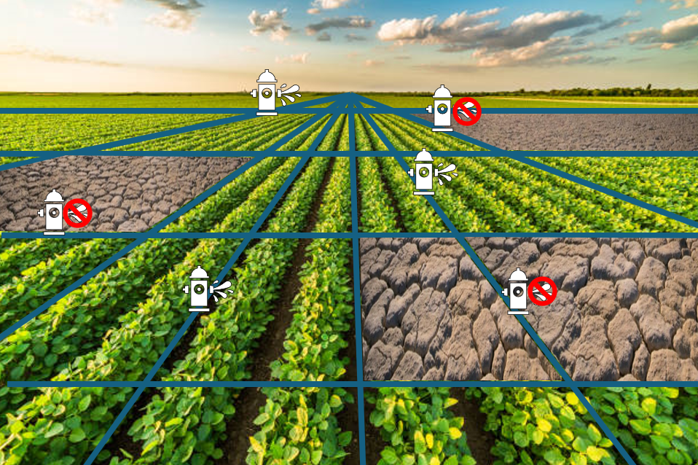
OASIS
Global Water Use
Problem
70%

Slide 23
Icon
You can resize these icons keeping the quality.
You can change the stroke and fill color;

